Slide 1
Process & Process Scheduling
Module 2

Slide 2

Process Concept
Program is passive entity stored on disk (executable file), process is active
Program becomes process when executable file loaded into memory
Execution of program started via GUI mouse clicks, command line entry of its name, etc
One program can be several processes
Consider multiple users executing the same program
Textbooks uses the terms job and process almost interchangeably
Process – a program in execution

Slide 3
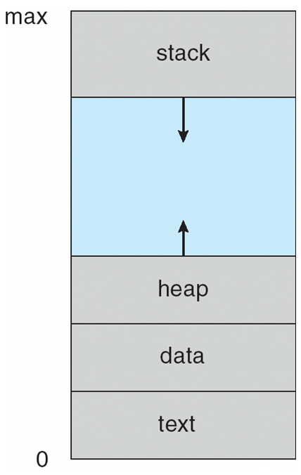

Process Description (Process in Memory)
The program code, also called text section
Current activity including program counter, processor registers
Stack containing temporary data
Function parameters, return addresses, local variables
Data section containing global variables
Heap containing memory dynamically allocated during run time

Slide 4
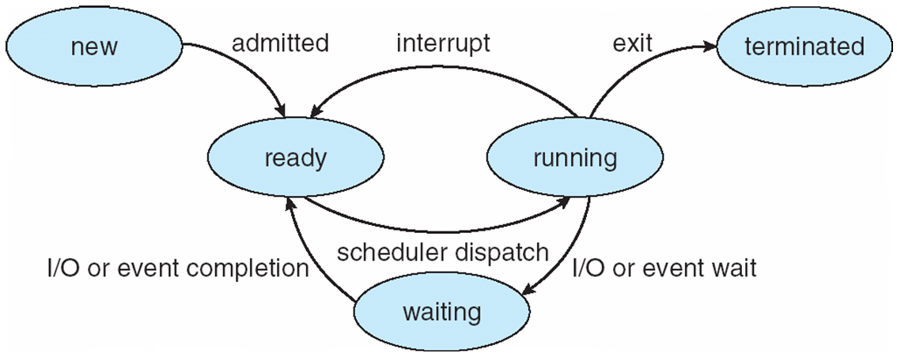

Process State
As a process executes, it changes state
new: The process is being created
running: Instructions are being executed
waiting: The process is waiting for some event to occur
ready: The process is waiting to be assigned to a processor
terminated: The process has finished execution

Slide 5

Process State diagram with 7 states

Slide 6
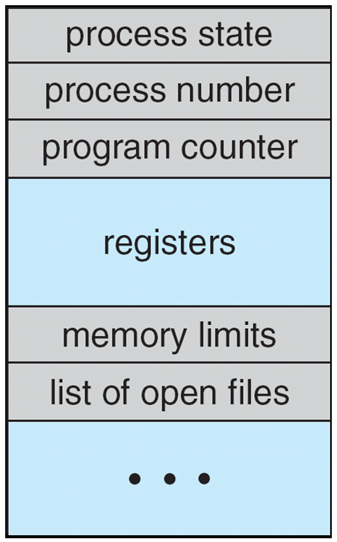

Process Control Block (PCB)
Information associated with each process
(PCB can be treated as an entry of process table)
Process state – running, waiting, etc..
Program counter – location of instruction to next execute
CPU registers – contents of all process-centric registers
CPU scheduling information- priorities, scheduling queue pointers
Memory-management information – memory allocated to the process
Accounting information – CPU used, clock time elapsed since start, time limits
I/O status information – I/O devices allocated to process, list of open files

Slide 7
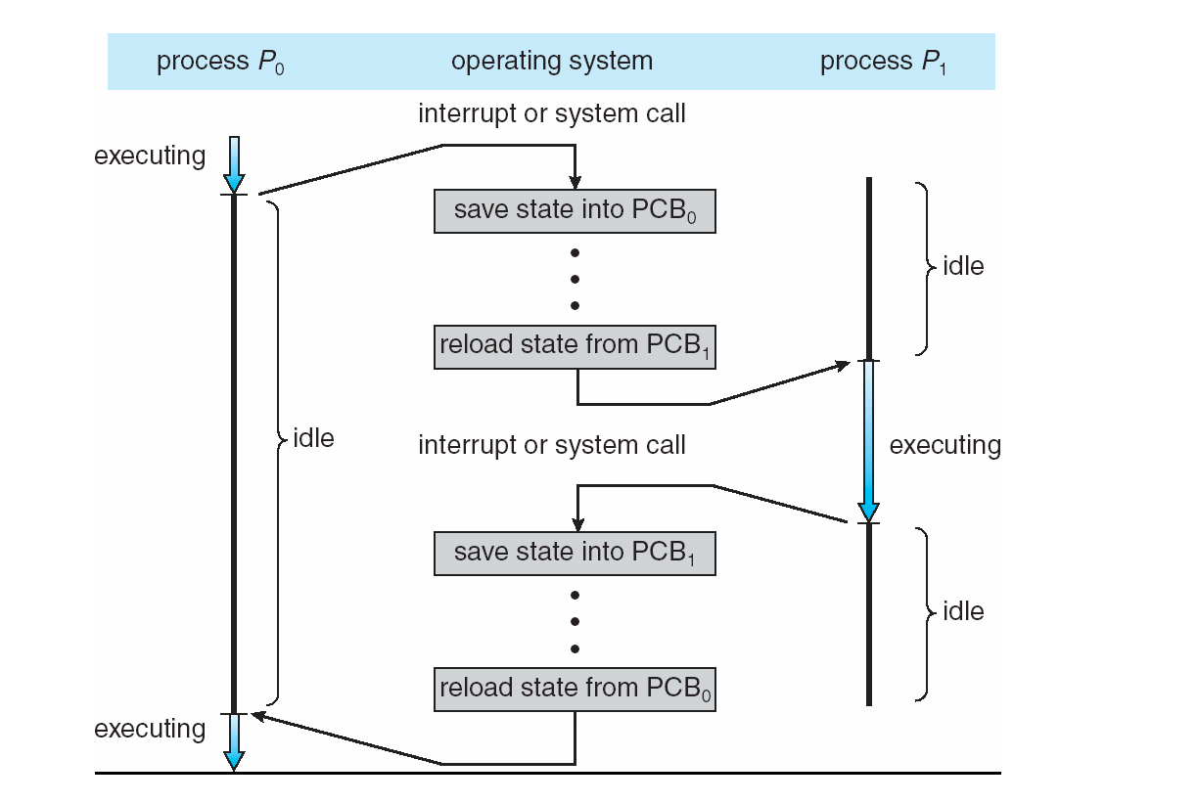
Context Switch
When CPU switches to another process, the system must save the state of the old process and load the saved state for the new process via a context switch
Context of a process represented in the PCB
Context-switch time is overhead; the system does no useful work while switching
The more complex the OS and the PCB ➔ the longer the context switch
Time dependent on hardware support
Some hardware provides multiple sets of registers per CPU ➔ multiple contexts loaded at once

Slide 8

Process Scheduler Types
Processes can be described as either:
I/O-bound process – spends more time doing I/O than computations, many short CPU bursts
CPU-bound process – spends more time doing computations; few very long CPU bursts
Long-term scheduler (or job scheduler) – selects which processes should be brought into the ready queue
Long-term scheduler is invoked infrequently (seconds, minutes) ⇒ (may be slow)
The long-term scheduler controls the degree of multiprogramming
Long-term scheduler strives for good process mix
Short-term scheduler (or CPU scheduler) – selects which process should be executed next and allocates CPU
Sometimes the only scheduler in a system
Short-term scheduler is invoked frequently (milliseconds) ⇒ (must be fast)
Short term scheduler selects among available processes for next execution on CPU
It aims to maximize CPU use, quickly switch processes onto CPU for time sharing

Slide 9
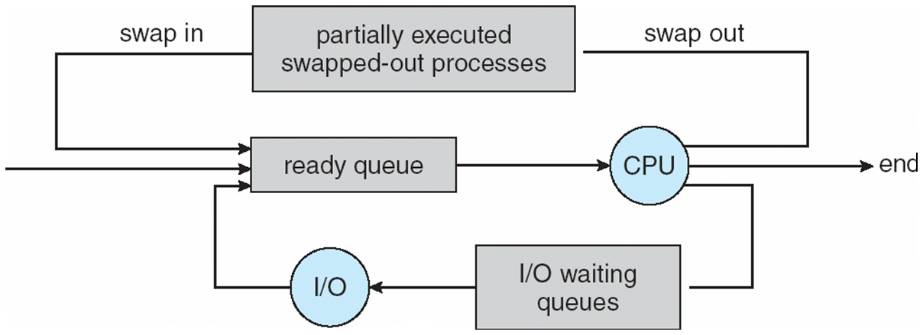

Addition of Medium Term Scheduler
Medium-term scheduler can be added if degree of multiple programming needs to decrease
Remove process from memory, store on disk, bring back in from disk to continue execution: swapping

Slide 10
CPU Scheduling
Short-term Scheduling techniques

Slide 11

CPU Scheduler
Short-term scheduler selects from among the processes in ready queue, and allocates the CPU to one of them
Queue may be ordered in various ways
CPU scheduling decisions may take place when a process:
Switches from running to waiting state
Terminates
Enters from waiting or new state to ready state
Scheduling under 1 and 2 is non-preemptive
Scheduling under all 3 criterions is preemptive

Slide 12
Scheduling Criteria/ Performance metrics
CPU utilization (Maximize)– keep the CPU as busy as possible
Throughput (Maximize)– # of processes that complete their execution per time unit
Turnaround time (Minimize) – amount of time to execute a particular process
Waiting time (Minimize) – amount of time a process has been waiting in the ready queue
Response time (Minimize) – amount of time it takes from when a request was submitted until the first response is produced, not output (for time-sharing environment)

Slide 13
First Come, First Served (FCFS) Scheduling
Process Burst Time
P₁ 24
P₂ 3
P₃ 3
Suppose that the processes arrive in the order: P₁ , P₂ , P₃ The Gantt Chart for the schedule is:
Waiting time for P₁ = 0; P₂ = 24; P₃ = 27
Average waiting time: (0 + 24 + 27)/3 = 17
Turn around time for P₁ = 24; P₂ = 27; P₃ = 30
Average turn-around time: (24 + 27 + 30)/3 = 27

Slide 14
FCFS (continued…)
Suppose that the processes arrive in the order:
P₂ , P₃ , P₁
The Gantt chart for the schedule is:
AWT: (6 + 0 + 3)/3 = 3 ATAT: (30+3+6)/3 = 13
Pid | Arrival Time (AT) | Burst Time (BT) | Completion Time (CT) | TAT = CT-AT | WT = TAT - BT
P₂ | 0 | 3 | 3 | 3 | 0
P₃ | 0 | 3 | 6 | 6 | 3
P₁ | 0 | 24 | 30 | 30 | 6

Slide 15
Shortest Job First (SJF) Scheduling
Associate with each process the length of its next CPU burst
Use these lengths to schedule the process with the shortest time
SJF is optimal – gives minimum average waiting time for a given set of processes
The difficulty is knowing the length of the next CPU request
Could ask the user
Starvation – Starvation is the name given to the indefinite postponement of a process because it requires some resource before it can run, but the resource, though available for allocation, is never allocated to this process.

Slide 16
Example of SJF
4 Processes with burst time 6, 8, 7 and 3 arrive at time 0.
SJF scheduling chart
AWT = (3 + 16 + 9 + 0) / 4 = 7 ATAT = (9+24+16+3)/4 = 13
Pid | AT | BT | CT | TAT = CT-AT | WT = TAT - BT
P₁ | 0 | 6 | 9 | 9 | 3
P₂ | 0 | 8 | 24 | 24 | 16
P₃ | 0 | 7 | 16 | 16 | 9
P₄ | 0 | 3 | 3 | 3 | 0

Slide 17
Example 2 of SJF (with varying Arrival Time)
What if not all processes arrive at time 0 ?
Consider 4 processes with burst time 6, 8, 7 and 3 arriving at time 0,1,2 and 3 respectively.
AWT = (0 + 15 + 7 + 3) / 4 = 6.25 ATAT = (6+23+14+6)/4 = 12.25
Pid | AT | BT | CT | TAT = CT-AT | WT = TAT - BT
P₁ | 0 | 6 | 6 | 6-0 = 6 | 6-6 = 0
P₂ | 1 | 8 | 24 | 24-1 = 23 | 23-8 = 15
P₃ | 2 | 7 | 16 | 16-2 = 14 | 14-7 = 7
P₄ | 3 | 3 | 9 | 9-3 = 6 | 6-3 = 3

Slide 18
Non-Preemptive Priority Scheduling
A priority number (integer) is associated with each process
The CPU is allocated to the process with the highest priority (smallest integer ≡ highest priority)
SJF is priority scheduling where priority is the inverse of predicted next CPU burst time
Problem ≡ Starvation – low priority processes may never execute
Solution ≡ Aging – as time progresses increase the priority of the process

Slide 19
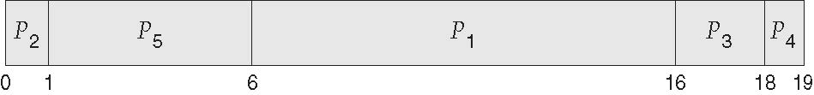
Example of Non-Preemptive Priority Scheduling
Consider 5 processes with burst time 10, 1, 2, 1 and 5 having priorities 3, 1, 4, 5 and 2 respectively arrive at time 0.
Scheduling chart
Pid | AT | BT | Priority | CT | TAT = CT – AT | WT = TAT – BT
P₁ | 0 | 10 | 3 | 16 | 16 | 6
P₂ | 0 | 1 | 1 | 1 | 1 | 0
P₃ | 0 | 2 | 4 | 18 | 18 | 16
P₄ | 0 | 1 | 5 | 19 | 19 | 18
P₅ | 0 | 5 | 2 | 6 | 6 | 1

Slide 20
Preemptive Priority Scheduling
Scheduler is active when
Running process terminates
Running process gets blocked
A new process arrives (in ready queue)
If the new process has higher priority than the running process, then
The running process is preempted and is moved to ready state.
The new process is moved from ready state to running state.
Preemption will increase the number of context switches and may increase probability of starvation of low priority process.

Slide 21
SJF Preemptive (Shortest Remaining Time First)
Gives priority to process having smallest burst time (Like SJF)
Keeps track of Remaining Time (Burst time – Time for which process has already executed)
If running process terminates or gets blocked: Selects the next ready process with smallest burst time (Like SJF)
If a new process arrives:
Scheduler compares Remaining Time of running process (say RT_{run}) with the Burst Time of newly arrived process (say BT_{ready})
Context Switch occurs iff BT_{ready} < RT_{run}

Slide 22
Example SRTF / SRTN / SJF Preemptive
Consider 4 processes having burst time 8, 4, 9 and 5 arrive at time 0, 1 , 2 and 3 respectively.
At t = 0: The only process in ready queue is P₁, hence scheduled
At t = 1: P₂ with BT=4 arrives. RT of P₁ = 8 – 1 = 7.
Since BT of new process is strictly lesser than RT of running, preemption occurs and P₂ is moved to running state.
At t = 2: P₃ with BT=9 arrives.
Since BT of new process is not strictly lesser than RT of running process (4 – 1 = 3), No preemption.
At t = 3: P₄ with BT=5 arrives. No preemption
From t = 4: 3 processes in queue with are scheduled as per their BT/RT. NOTE: RT of P₁ is 7 (it has already executed for 1 time unit)

Slide 23
Example continued …..
Pid | AT | BT | CT | TAT = CT – AT | WT = TAT – BT (Time waited)
P₁ | 0 | 8 | 17 | 17 | 9 (10 – 1)
P₂ | 1 | 4 | 5 | 4 | 0 (1 – 1)
P₃ | 2 | 9 | 26 | 24 | 15 (17 – 2)
P₄ | 3 | 5 | 10 | 7 | 2 (5 – 3)
Average Waiting Time = (9 + 0 + 15 + 2) / 4 = 6.5

Slide 24
Round Robin (RR)
Each process gets a small unit of CPU time (time quantum q), usually 10-100 milliseconds. After this time has elapsed, the process is preempted and added to the end of the ready queue.
If there are n processes in the ready queue and the time quantum is q, then each process gets 1/n of the CPU time in chunks of at most q time units at once. No process waits more than (n-1)q time units.
Timer interrupts every quantum to schedule next process
Performance
q large ⇒ FIFO
q small ⇒ q must be large with respect to context switch, otherwise overhead is too high

Slide 25
Example Round Robin
Consider 3 process having burst time 24, 3 and 3 respectively arriving at time 0. Assume time quantum of 4 units.
Average Turn-around and Waiting time is higher than SJF and SRTF
Average Response Time improves (i.e lesser response time / faster response)
Useful for interactive jobs.

Slide 26
Multilevel Queue
Ready queue is partitioned into separate queues, eg:
foreground (interactive)
background (batch)
Process permanently in a given queue
Each queue has its own scheduling algorithm:
foreground – RR
background – FCFS
Scheduling must be done between the queues:
Fixed priority scheduling; (i.e., serve all from foreground then from background). Possibility of starvation.
Time slice – each queue gets a certain amount of CPU time which it can schedule amongst its processes; i.e., 80% to foreground in RR
20% to background in FCFS

Slide 27
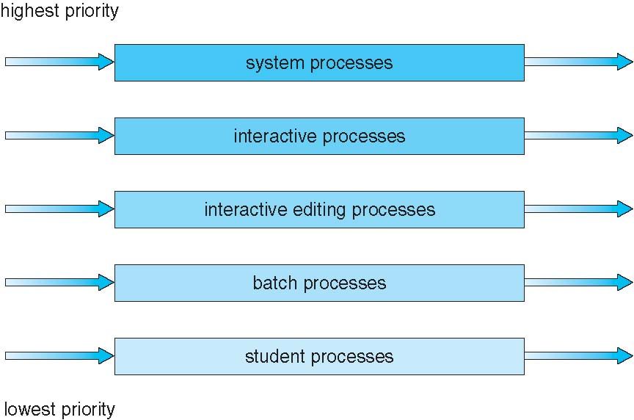
Multilevel Queue - One possibility

Slide 28
Multilevel Feedback Queue
A process can move between the various queues; aging can be implemented this way
Multilevel-feedback-queue scheduler defined by the following parameters:
number of queues
scheduling algorithms for each queue
method used to determine when to upgrade a process
method used to determine when to demote a process
method used to determine which queue a process will enter when that process needs service

Slide 29
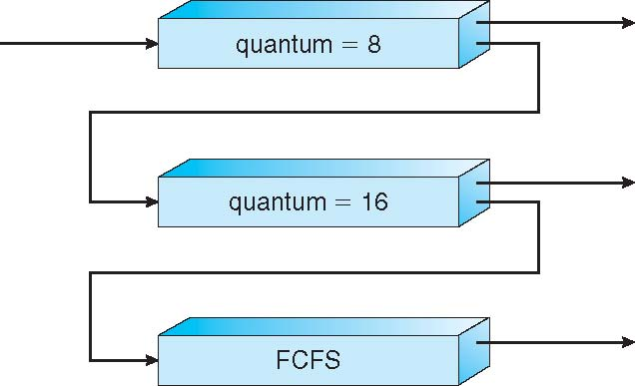
Multilevel Feedback Queue – One possiblity

Slide 30
Traditional Processes
Traditional processes have two characteristics:
Resource Ownership
Scheduling/Execution
Process includes a virtual address space to hold the process image
the OS provides protection to prevent unwanted interference between processes with respect to resources
Follows an execution path that may be interleaved with other processes
a process has an execution state (Running, Ready, etc.) and a dispatching priority and is scheduled and dispatched by the OS
Traditional processes are sequential; i.e. only one execution path

Slide 31
Processes and Threads
Multithreading - The ability of an OS to support multiple, concurrent paths of execution within a single process
The unit of resource ownership is referred to as a process or task
The unit of dispatching is referred to as a thread or lightweight process
Notes:
To distinguish the two characteristics, the unit of dispatching is usually referred to as a thread or lightweight process , while the unit of resource ownership is usually referred to as a process or task .
Multithreading refers to the ability of an OS to support multiple, concurrent paths of execution within a single process.

Slide 32
Benefits of Threads
Takes less time to create a new thread than a process
Less time to terminate a thread than a process
Switching between two threads takes less time than switching between processes
Threads enhance efficiency in communication between programs
Notes:
Thus, all of the threads of a process share the state and resources of that process. They reside in the same address space and have access to the same data. When one thread alters an item of data in memory, other threads see the results if and when they access that item. If one thread opens a file with read privileges, other threads in the same process can also read from that file.
The key benefits of threads derive from the performance implications:
1. It takes far less time to create a new thread in an existing process than to
create a brand-new process. Studies done by the Mach developers show that
thread creation is ten times faster than process creation in UNIX [TEVA87].
2. It takes less time to terminate a thread than a process.
3. It takes less time to switch between two threads within the same process than to switch between processes.
4. Threads enhance efficiency in communication between different executing programs. In most operating systems, communication between independent processes requires the intervention of the kernel to provide protection and the mechanisms needed for communication. However, because threads within the same process share memory and files, they can communicate with each other without invoking the kernel.
Thus, if there is an application or function that should be implemented as a set of related units of execution, it is far more efficient to do so as a collection of threads rather than a collection of separate processes.

Slide 33
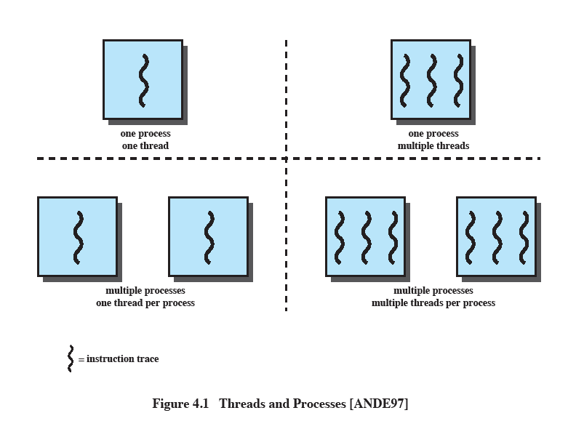
Single and Multithreaded Approaches
The left half of the figure depicts single threaded approach
A single execution path per process, in which the concept of a thread is not recognized, is referred to as a single-threaded approach
MS-DOS, some versions of UNIX supported only this type of process.
Notes:
The traditional approach of a single thread of execution per process, in which the concept of a thread is not recognized, is referred to as a single-threaded approach. The two arrangements shown in the left half of Figure 4.1 are single-threaded approaches. MS-DOS is an example of an OS that supports a single user process and a single thread.

Slide 34
Single and Multithreaded Approaches
The right half of Figure depicts multithreaded approaches
A Java run-time environment is a system of one process with multiple threads; Windows, some UNIX versions, support multiple multithreaded processes.
Notes:
The right half of Figure 4.1 depicts multithreaded approaches. A Java run-time environment is an example of a system of one process with multiple threads. Of interest in this section is the use of multiple processes, each of which supports multiple threads. This approach is taken in Windows, Solaris, and many modern versions of UNIX, among others. In this section we give a general description of multithreading; the details of the Windows, Solaris, and Linux approaches are discussed later in this chapter.

Slide 35

Processes in Multithreaded environment
In a multithreaded environment the process is the unit that owns resources and the unit of protection. i.e., the OS provides protection at the process level
Processes have
A virtual address space that holds the process image
Protected access to
processors
other processes
files
I/O resources
Notes:
In a multithreaded environment, a process is defined as the unit of resource allocation and a unit of protection. The following are associated with processes:
• A virtual address space that holds the process image
• Protected access to processors, other processes (for interprocess communication), files, and I/O resources (devices and channels)

Slide 36
Advantage of Multithreaded Process
Achieves concurrency without the overhead of using multiple processes
Threads within the same process can exchange information through their common address space and have access to the shared resources of the process
Threads in different processes can exchange information through shared memory that has been set up between the two processes
Notes:
Windows supports concurrency among processes because threads in different processes may execute concurrently (appear to run at the same time). Moreover, multiple threads within the same process may be allocated to separate processors and execute simultaneously (actually run at the same time). A multithreaded process achieves concurrency without the overhead of using multiple processes. Threads within the same process can exchange information through their common address space and have access to the shared resources of the process. Threads in different processes can exchange information through shared memory that has been set up between the two processes.
An object-oriented multithreaded process is an efficient means of implementing a server application. For example, one server process can service a number of clients concurrently.

Slide 37
One or More Threads in a Process
Each thread has:
an execution state (Running, Ready, etc.)
saved thread context when not running (TCB)
an execution stack
some per-thread static storage for local variables
access to the shared memory and resources of its process (all threads of a process share this)
Notes:
Within a process, there may be one or more threads, each with the following:
• A thread execution state (Running, Ready, etc.)
• A saved thread context when not running; one way to view a thread is as an independent program counter operating within a process
• An execution stack
• Some per-thread static storage for local variables
• Access to the memory and resources of its process, shared with all other threads in that process

Slide 38
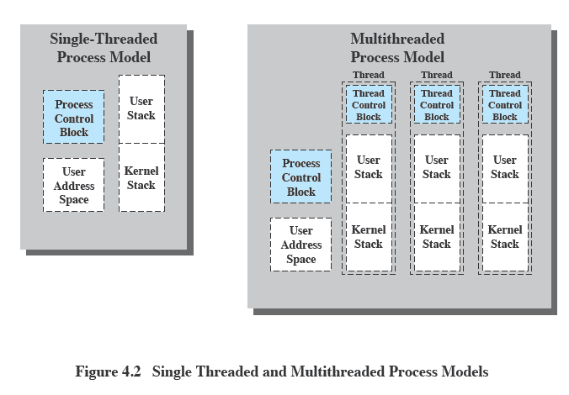
Single and multithreaded processes model
Notes:
Figure 4.2 illustrates the distinction between threads and processes from the point of view of process management. In a single-threaded process model (i.e., there is no distinct concept of thread), the representation of a process includes its process control block and user address space, as well as user and kernel stacks to manage the call/return behavior of the execution of the process. While the process is running, it controls the processor registers. The contents of these registers are saved when the process is not running. In a multithreaded environment, there is still a single process control block and user address space associated with the process, but now there are separate stacks for each thread, as well as a separate control block for each thread containing register values, priority, and other thread-related state information.

Slide 39
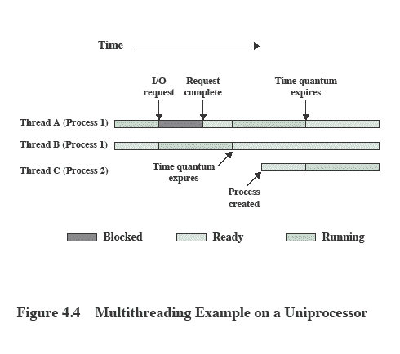
Multithreading Example on a Uniprocessor
Notes:
On a uniprocessor, multiprogramming enables the interleaving of multiple threads within multiple processes. In the example of Figure 4.4 , three threads in two processes are interleaved on the processor. Execution passes from one thread to another either when the currently running thread is blocked or when its time slice is exhausted.

Slide 40
Types of Threads
User Level Thread (ULT)
Kernel level Thread (KLT)
NOTE: we are talking about threads for user processes. Both ULT & KLT execute in user mode. An OS may also have threads but that is not what we are discussing here.
Notes:
User-Level and Kernel-Level Threads
There are two broad categories of thread implementation: user-level threads (ULTs) and kernel-level threads (KLTs). The latter are also referred to in the literature as kernel-supported threads or lightweight processes.

Slide 41
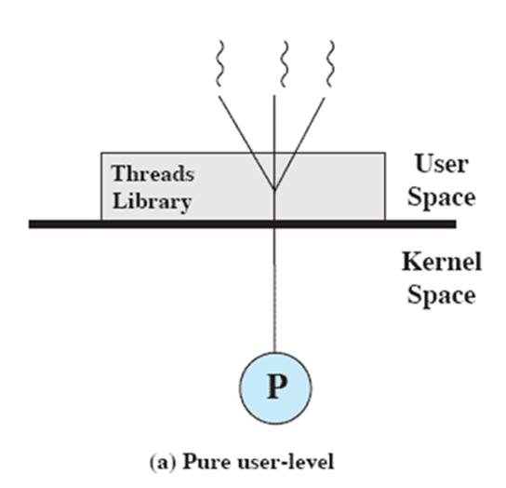
User-Level Threads (ULTs)
Thread management is done by the application
The kernel is not aware of the existence of threads
Not the kind we’ve discussed so far.
Notes:
USER-LEVEL THREADS
In a pure ULT facility, all of the work of thread management is done by the application and the kernel is not aware of the existence of threads. Figure 4.5a illustrates the pure ULT approach. Any application can be programmed to be multithreaded by using a threads library, which is a package of routines for ULT management. The threads library contains code for creating and destroying threads, for passing messages and data between threads, for scheduling thread execution, and for saving and restoring thread contexts.
By default, an application begins with a single thread and begins running in that thread. This application and its thread are allocated to a single process managed by the kernel. At any time that the application is running (the process is in the Running state), the application may spawn a new thread to run within the same process. Spawning is done by invoking the spawn utility in the threads library. Control is passed to that utility by a procedure call. The threads library creates a data structure for the new thread and then passes control to one of the threads within this process that is in the Ready state, using some scheduling algorithm. When control is passed to the library, the context of the current thread is saved, and when control is passed from the library to a thread, the context of that thread is restored. The context essentially consists of the contents of user registers, the program counter, and stack pointers.

Slide 42
Advantages of ULTs
Thread switching does not require kernel mode privileges (no mode switches)
Scheduling can be application specific
ULTs can run on any OS
Notes:
There are a number of advantages to the use of ULTs instead of KLTs, including the following:
1. Thread switching does not require kernel mode privileges because all of the
thread management data structures are within the user address space of a single process. Therefore, the process does not switch to the kernel mode to do thread management. This saves the overhead of two mode switches (user to kernel; kernel back to user).
2. Scheduling can be application specific. One application may benefit most
from a simple round-robin scheduling algorithm, while another might benefit from a priority-based scheduling algorithm. The scheduling algorithm can be tailored to the application without disturbing the underlying OS scheduler.
3. ULTs can run on any OS. No changes are required to the underlying kernel
to support ULTs. The threads library is a set of application-level functions shared by all applications.

Slide 43
Disadvantages of ULTs
In a typical OS many system calls are blocking
as a result, when a ULT executes a system call, not only is that thread blocked, but all of the threads within the process are blocked
In a pure ULT strategy, a multithreaded application cannot take advantage of multiprocessing
Notes:
There are two distinct disadvantages of ULTs compared to KLTs:
1. In a typical OS, many system calls are blocking. As a result, when a ULT
executes a system call, not only is that thread blocked, but also all of the threads within the process are blocked.
2. In a pure ULT strategy, a multithreaded application cannot take advantage
of multiprocessing. A kernel assigns one process to only one processor at a time. Therefore, only a single thread within a process can execute at a time. In effect, we have application-level multiprogramming within a single process. While this multiprogramming can result in a significant speedup of the application, there are applications that would benefit from the ability to execute portions of code simultaneously.

Slide 44
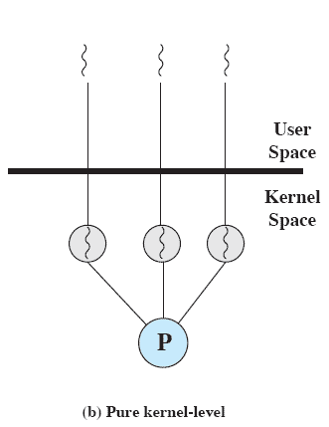
Kernel-Level Threads (KLTs)
Thread management is done by the kernel (could call them KMT)
no thread management is done by the application
Windows is an example of this approach
Notes:
KERNEL-LEVEL THREADS
In a pure KLT facility, all of the work of thread management is done by the kernel. There is no thread management code in the application level, simply an application programming interface (API) to the kernel thread facility. Windows is an example of this approach. Figure 4.5b depicts the pure KLT approach. The kernel maintains context
information for the process as a whole and for individual threads within the process.

Slide 45
Advantages of KLTs
The kernel can simultaneously schedule multiple threads from the same process on multiple processors
If one thread in a process is blocked, the kernel can schedule another thread of the same process
Notes:
Scheduling by the kernel is done on a thread basis. This approach overcomes the two principal drawbacks of the ULT approach. First, the kernel can simultaneously schedule multiple threads from the same process on multiple processors. Second, if one thread in a process is blocked, the kernel can schedule another thread of the same process. Another advantage of the KLT approach is that kernel routines themselves can be multithreaded.

Slide 46
Disadvantage of KLTs
The transfer of control from one thread to another within the same process requires a mode switch to the kernel
Notes:
The principal disadvantage of the KLT approach compared to the ULT approach is that the transfer of control from one thread to another within the same process requires a mode switch to the kernel. To illustrate the differences, Table 4.1 shows the results of measurements taken on a uniprocessor VAX computer running a UNIX-like OS. The two benchmarks are as follows: Null Fork, the time to create, schedule, execute, and complete a process/thread that invokes the null procedure (i.e., the overhead of forking a process/thread); and Signal-Wait, the time for a process/thread to signal a waiting process/thread and then wait on a condition (i.e., the overhead of synchronizing two processes/threads together). We see that there is
an order of magnitude or more of difference between ULTs and KLTs and similarly between KLTs and processes.

Slide 47
Comparison of ULT and KLT level threads
User level thread | Kernel level thread
User thread are implemented by users. | kernel threads are implemented by OS.
OS doesn’t recognized user level threads. | Kernel threads are recognized by OS.
Implementation of User threads is easy. | Implementation of Kernel thread is complicated.
Context switch time is less. | Context switch time is more.
Context switch requires no hardware support. | Hardware support is needed.
If one user level thread perform blocking operation then entire process will be blocked. | If one kernel thread perform blocking operation then another thread can continue execution.
User level threads are designed as dependent threads. | Kernel level threads are designed as independent threads.
Example : Java thread, POSIX threads. | Example : Window Solaris.

Slide 48
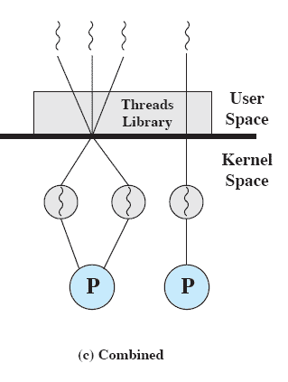
Combined Approaches
Thread creation is done in the user space
Bulk of scheduling and synchronization of threads is by the application
Solaris is an example
Notes:
COMBINED APPROACHES
Some operating systems provide a combined ULT/ KLT facility ( Figure 4.5c ). In a combined system, thread creation is done completely in user space, as is the bulk of the scheduling and synchronization of threads within an application. The multiple ULTs from a single application are mapped onto some (smaller or equal) number of KLTs. The programmer may
adjust the number of KLTs for a particular application and processor to achieve the best overall results. In a combined approach, multiple threads within the same application can run in parallel on multiple processors, and a blocking system call need not block the entire process. If properly designed, this approach should combine the advantages of the pure ULT and KLT approaches while minimizing the disadvantages. Solaris is a good example of an OS using this combined approach. The current Solaris version limits the ULT/KLT relationship to be one-to-one.

Slide 49
Multithreading Models
Many-to-One
One-to-One
Many-to-Many

Slide 50
Many-to-One
Many user-level threads mapped to single kernel thread
One thread blocking causes all to block
Multiple threads may not run in parallel on muticore system because only one may be in kernel at a time
Few systems currently use this model
Examples:
Solaris Green Threads
GNU Portable Threads

Slide 51

One-to-One
Each user-level thread maps to kernel thread
Creating a user-level thread creates a kernel thread
More concurrency than many-to-one
Number of threads per process sometimes restricted due to overhead
Examples
Windows
Linux

Slide 52
Many-to-Many Model
Allows many user level threads to be mapped to many kernel threads
Allows the operating system to create a sufficient number of kernel threads
Solaris prior to version 9
Windows with the ThreadFiber package

Slide 53

Thank You…

